Slide 1


Logistic Regression
06
PART II · LINEAR MODELS AND GENERALIZATION
CHAPTER 6 · WEEK 5
Machine Learning — From Hypotheses to Decisions
LECTURER
Dr. Mustafa Hameed
THE ISLAMIA UNIVERSITY OF BAHAWALPUR
Bahawalpur, Pakistan
Department of Information Technology · BSIT · Fall 2026
Notes:
Chapter 6: Logistic Regression. Part 2 — Linear Models and Generalization. Week 5: Logistic regression. Handout pages 45–51.

Slide 2

Where this chapter sits
THE COURSE
PART I
PART II
PART III
PART IV
PART V
PART VI
1
2
3
4
5
6
7
8
9
10
11
12
13
14
15
16
17
18
19
20
21
22
Logistic Regression
BUILDS ON
USED LATER IN
Ch 2 Mathematics for Machine Learning
Ch 7 Overfitting, Bias–Variance and Regularisation
Ch 5 Linear Regression
Ch 8 Measuring Classifier Performance
Ch 12 Support Vector Machines
Ch 13 Artificial Neural Networks
Ch 21 Responsible and Ethical Machine Learning
Machine Learning · Chapter 6 · Logistic Regression
Handout p. 45 2
Notes:
Place the chapter. Before you start: Chapter 5 (the linear model, gradient descent on a loss) and Chapter 2 (maximum likelihood, logarithms, the chain rule).

Slide 3

What you will be able to do
LEARNING OUTCOMES
By the end of this chapter you will be able to:
1
Explain why linear regression is unsuitable for classification.
2
Compute a class probability with the sigmoid function, and interpret a weight as a change in log-odds and an odds ratio.
3
Find and draw the decision boundary of a logistic regression model.
4
Compute the cross-entropy loss and perform a gradient descent step by hand.
5
Extend the model to several classes with one-vs-rest and softmax.
Machine Learning · Chapter 6 · Logistic Regression
Handout p. 45 3
Notes:
Read these out: they are the chapter's contract with the room. Each click adds one.

Slide 4

Vocabulary for this chapter
KEY TERMS
binary classification
sigmoid (logistic) function
odds
log-odds (logit)
odds ratio
decision boundary
threshold
cross-entropy (log loss)
linear separability
one-vs-rest
softmax
Each term is defined where it first matters — not here.
Machine Learning · Chapter 6 · Logistic Regression
Handout p. 45 4
Notes:
Do not define these now; they arrive one at a time. This slide is for the students' notes. Terms: binary classification; sigmoid (logistic) function; odds; log-odds (logit); odds ratio; decision boundary; threshold; cross-entropy (log loss); linear separability; one-vs-rest; softmax.

Slide 5

In this chapter
IN THIS CHAPTER
6.1
Why Not Just Use Linear Regression?
p. 45 ›
6.2
The Sigmoid and the Log-Odds
p. 46 ›
6.3
The Decision Boundary
p. 46 ›
6.4
The Loss: Cross-Entropy
p. 47 ›
6.5
Fitting by Gradient Descent
p. 48 ›
6.6
More Than Two Classes
p. 48 ›
Machine Learning · Chapter 6 · Logistic Regression
Handout pp. 45–51 5
Notes:
The route through the chapter. Each row is a link: click it to jump to that section in the slide show.

Slide 6
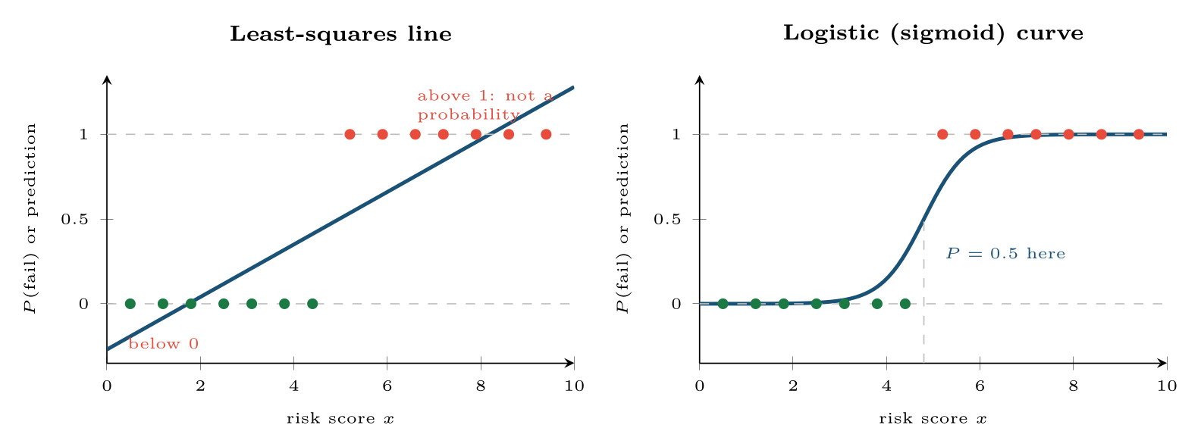
The same pass (green) and fail (red) students modelled two ways
FIGURE 6.1
The straight line leaves [0,1] and is pulled by easy cases; the sigmoid stays between 0 and 1 and flattens out where the answer is already clear.
Machine Learning · Chapter 6 · Logistic Regression
§6.1 · Handout p. 45 6
Notes:
Code a binary label as y = 1 (fail) or y = 0 (pass), fit a least-squares line, and call anything above 0.5 a fail. It half works — and it breaks in two ways, both visible on the left of Figure 6.1. The line predicts values below 0 and above 1, which cannot be probabilities. And a few examples far from the boundary — a student with perfect attendance, who of course passed — drag the line towards them and move the 0.5 crossing, misclassifying students near the boundary who were previously correct. The model is being penalised for being too right about easy cases.
Figure 6.1 (handout p. 45): The same pass (green) and fail (red) students modelled two ways. The straight line leaves [0,1] and is pulled by easy cases; the sigmoid stays between 0 and 1 and flattens out where the answer is already clear.

Slide 7
The Sigmoid and the Log-Odds
SECTION 2 OF 6
6.2
6.1 Why Not Just Use Linear Regression?
6.2 The Sigmoid and the Log-Odds
6.3 The Decision Boundary
6.4 The Loss: Cross-Entropy
6.5 Fitting by Gradient Descent
6.6 More Than Two Classes
Machine Learning · Chapter 6
Handout §6.2 7
Notes:
Pause. Name the question this section answers.

Slide 8

Logistic Regression
DEFINITION
Compute a linear score z = w·x + b exactly as in linear regression, then squash it into (0, 1) with the sigmoid (logistic) function:
σ(0) = 0.5; large positive z gives a probability near 1 and large negative z a probability near 0. Predict class 1 when the probability exceeds a threshold, by default 0.5.
Machine Learning · Chapter 6 · Logistic Regression
§6.2 · Handout p. 46 8
Notes:
Read the box aloud, then ask for an example from the room before moving on.

Slide 9
The Sigmoid and the Log-Odds
IN BRIEF
Inverting the sigmoid shows what the linear score means. If p = σ(z) then
Machine Learning · Chapter 6 · Logistic Regression
§6.2 · Handout p. 46 9
Notes:
Inverting the sigmoid shows what the linear score means. If p = σ(z) then

Slide 10

Probabilities and Odds for Two Students
WORKED EXAMPLE
A fitted model of failing: z = 4 − 5 a − 3 q, where a is attendance and q the quiz average, both on a 0–1 scale.
Reading the attendance weight. w_{a} = −5 per unit of attendance, so ten percentage points more attendance (+0.1) changes the log-odds by −0.5 and multiplies the odds of failing by e^{−0.5} = 0.61 — a 39% reduction in the odds, whatever the student’s starting point. Note: the odds, not the probability. For Student A the probability barely moves; for Student B, near the middle of the curve, it moves a lot.
Machine Learning · Chapter 6 · Logistic Regression
§6.2 · Handout p. 46 10
Notes:
The ratio p/(1−p) is the odds — a probability of 0.8 is odds of 4 to 1 — and its logarithm is the log-odds or logit. So logistic regression is a linear model of the log-odds. Each weight is the change in log-odds for a one-unit increase in its feature, and ewj is the odds ratio: the factor by which the odds are multiplied.
Each click adds one step of the working. Ask for the next number before you reveal it.

Slide 11
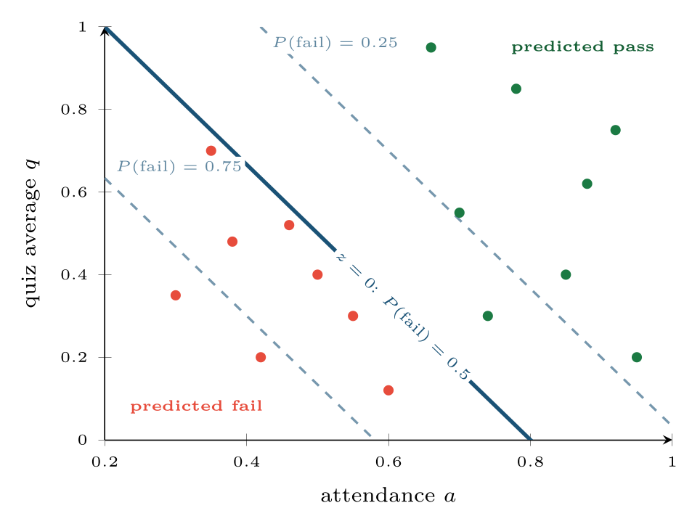
The decision boundary of the model z = 4 − 5a − 3q is the line 5a + 3q = 4
FIGURE 6.2
The dashed lines, where z = ±ln 3, are where the probability of failing is 0.75 and 0.25: probability changes gradually across the boundary.
Machine Learning · Chapter 6 · Logistic Regression
§6.3 · Handout p. 46 11
Notes:
The model predicts class 1 when σ(z) > 0.5, which happens exactly when z > 0. So the decision boundary is the set of points where w·x + b = 0: a straight line in two dimensions, a plane in three, a hyperplane in general. Logistic regression is a linear classifier; it can separate classes only with a flat boundary.
Figure 6.2 (handout p. 47): The decision boundary of the model z = 4 − 5a − 3q is the line 5a + 3q = 4. The dashed lines, where z = ±ln 3, are where the probability of failing is 0.75 and 0.25: probability changes gradually across the boundary.

Slide 12
The Loss: Cross-Entropy
SECTION 4 OF 6
6.4
6.1 Why Not Just Use Linear Regression?
6.2 The Sigmoid and the Log-Odds
6.3 The Decision Boundary
6.4 The Loss: Cross-Entropy
6.5 Fitting by Gradient Descent
6.6 More Than Two Classes
Machine Learning · Chapter 6
Handout §6.4 12
Notes:
Pause. Name the question this section answers.

Slide 13
Cross-Entropy (Log Loss)
DEFINITION
For each example only one term survives: −ln p_{i} if the label is 1, −ln(1 − p_{i}) if it is 0. The loss is convex — one bowl, one minimum — so gradient descent finds the best weights from any start.
Machine Learning · Chapter 6 · Logistic Regression
§6.4 · Handout p. 47 13
Notes:
Squared error is the wrong loss for probabilities: combined with the sigmoid it gives a bumpy surface with flat regions where gradient descent stalls. The right loss comes, again, from maximum likelihood. If the model gives probability pi to class 1, the likelihood of the observed label is pi when yi = 1 and 1 − pi when yi = 0. Taking minus the average log of that gives:

Slide 14
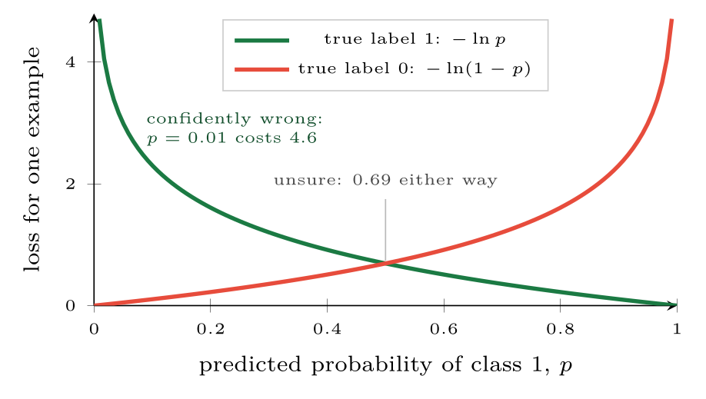
Cross-entropy punishes confident mistakes without limit
FIGURE 6.3
Being right at 0.9 costs 0.11; being wrong at 0.99 costs 4.6.
Machine Learning · Chapter 6 · Logistic Regression
§6.4 · Handout p. 47 14
Notes:
Figure 6.3 (handout p. 47): Cross-entropy punishes confident mistakes without limit. Being right at 0.9 costs 0.11; being wrong at 0.99 costs 4.6.

Slide 15
Cross-Entropy on Four Predictions
WORKED EXAMPLE
• Label 1, predicted p = 0.9: loss −ln 0.9 = 0.105.
• Label 1, predicted p = 0.6: loss −ln 0.6 = 0.511.
• Label 0, predicted p = 0.2: loss −ln 0.8 = 0.223.
• Label 0, predicted p = 0.7: loss −ln 0.3 = 1.204.
Average: (0.105 + 0.511 + 0.223 + 1.204)/4 = 0.511.
The last example is the only one misclassified at a 0.5 threshold, and it contributes more than half the total. Replace it by a label-1 example predicted at p = 0.01 and that one example alone costs −ln 0.01 = 4.6. Cross-entropy cares not just whether you are wrong, but how sure you were.
Machine Learning · Chapter 6 · Logistic Regression
§6.4 · Handout p. 47 15
Notes:
Each click adds one step of the working. Ask for the next number before you reveal it.

Slide 16
Fitting by Gradient Descent
SECTION 5 OF 6
6.5
6.1 Why Not Just Use Linear Regression?
6.2 The Sigmoid and the Log-Odds
6.3 The Decision Boundary
6.4 The Loss: Cross-Entropy
6.5 Fitting by Gradient Descent
6.6 More Than Two Classes
Machine Learning · Chapter 6
Handout §6.5 16
Notes:
Pause. Name the question this section answers.

Slide 17
Fitting by Gradient Descent
IN BRIEF
Differentiating the cross-entropy through the sigmoid, most of the algebra cancels and leaves a result of exactly the same shape as linear regression’s:
Machine Learning · Chapter 6 · Logistic Regression
§6.5 · Handout p. 48 17
Notes:
Differentiating the cross-entropy through the sigmoid, most of the algebra cancels and leaves a result of exactly the same shape as linear regression’s:

Slide 18
One Gradient Descent Step
WORKED EXAMPLE
Four examples with one feature: x = 1, 2, 3, 4 and labels y = 0, 0, 1, 1. Start at w = 0, b = 0 with learning rate α = 1.
Predictions: z = 0 everywhere, so p = 0.5 for all four, and the loss is −ln 0.5 = 0.693.
Errors p − y: 0.5, 0.5, −0.5, −0.5.
Update: w ← 0 − 1 × (−0.5) = 0.5; b is unchanged.
New probabilities σ(0.5x): 0.62, 0.73, 0.82, 0.88. The loss falls to 0.654. The two class-1 examples are already right; the next steps will push b negative so that the first two fall below 0.5 as well.
Machine Learning · Chapter 6 · Logistic Regression
§6.5 · Handout p. 48 18
Notes:
Error times feature, averaged — with the error now measured in probability.
Each click adds one step of the working. Ask for the next number before you reveal it.

Slide 19

When the Classes Can Be Separated Perfectly
WATCH OUT
In the worked example a single threshold, x = 2.5, separates the classes with no errors. The loss can then always be reduced by making the sigmoid steeper, so the weights grow without limit: after 5,000 steps w ≈ 8.9 and still rising, while the boundary settles at x ≈ 2.5. The fix is regularisation (Chapter 7), which scikit-learn applies by default — that is what its parameter C controls.
Machine Learning · Chapter 6 · Logistic Regression
§6.5 · Handout p. 48 19
Notes:
Read the box aloud, then ask for an example from the room before moving on.

Slide 20
More Than Two Classes
IN BRIEF
One-vs-rest trains one binary classifier per class (“class k or not?”) and predicts the class whose classifier is most confident. Softmax (multinomial) regression is the direct generalisation: one linear score per class, turned into probabilities that sum to 1:
Machine Learning · Chapter 6 · Logistic Regression
§6.6 · Handout p. 48 20
Notes:
One-vs-rest trains one binary classifier per class (“class k or not?”) and predicts the class whose classifier is most confident. Softmax (multinomial) regression is the direct generalisation: one linear score per class, turned into probabilities that sum to 1:

Slide 21
Softmax on Three Scores
WORKED EXAMPLE
A network-traffic classifier gives scores z = (2.0, 1.0, 0.1) for the classes web, e-mail and streaming.
Adding the same constant to every score leaves the probabilities unchanged — only the differences between scores matter. The same function is the output layer of almost every neural network classifier (Chapter 13).
Machine Learning · Chapter 6 · Logistic Regression
§6.6 · Handout p. 48 21
Notes:
Each click adds one step of the working. Ask for the next number before you reveal it.

Slide 22

Common pitfalls
COMMON PITFALLS
✕
Reading a weight as a change in probability. It is a change in log-odds. The effect on probability depends on where on the curve you start.
✕
Assuming the 0.5 threshold is right. It is a default. When the two errors cost different amounts, move it (Chapter 8).
✕
Forgetting that the boundary is linear. If the classes are separated by a curve, add features (squares, products) or use a non-linear model (Part III).
✕
Comparing weights of unscaled features. As in Chapter 5, standardise first.
✕
Trusting probabilities from an unregularised model on separable data. They will all be pushed to 0 or 1.
Machine Learning · Chapter 6 · Logistic Regression
§6.6 · Handout p. 48 22
Notes:
For each pitfall, ask who has seen it happen. One real story beats five bullets.

Slide 23





Four lenses: Logistic Regression
FOUR LENSES
LEARNING ANALYTICS
PROJECT MANAGEMENT
The standard early-warning model.
Predict whether a project will overrun its deadline from team size, requirement changes and dependencies.
INTERNET OF THINGS
CYBERSECURITY
Predict whether a component fails within 30 days from its sensor summaries.
Phishing and spam filters were logistic regression over word and URL features for years, and many still are.
Machine Learning · Chapter 6 · Logistic Regression
Handout p. 51 23
Notes:
The same method, four domains. Each of the next four slides opens one lens in full.

Slide 24

Learning Analytics: Logistic Regression
FOUR LENSES
LEARNING ANALYTICS
Project Management
The standard early-warning model. The probability ranks students for outreach, and the odds ratios — “each missed quiz multiplies the odds of failing by 1.4” — are something an academic committee will accept, which a more accurate but opaque model may not be.
Internet of Things
Cybersecurity
Machine Learning · Chapter 6 · Logistic Regression
Handout p. 51 24
Notes:
Learning Analytics. The standard early-warning model. The probability ranks students for outreach, and the odds ratios — “each missed quiz multiplies the odds of failing by 1.4” — are something an academic committee will accept, which a more accurate but opaque model may not be.

Slide 25

Project Management: Logistic Regression
FOUR LENSES
PROJECT MANAGEMENT
Learning Analytics
Predict whether a project will overrun its deadline from team size, requirement changes and dependencies. With a few hundred projects, logistic regression is often as accurate as anything more complex, and its odds ratios tell a portfolio manager which risk factor to act on first.
Internet of Things
Cybersecurity
Machine Learning · Chapter 6 · Logistic Regression
Handout p. 51 25
Notes:
Project Management. Predict whether a project will overrun its deadline from team size, requirement changes and dependencies. With a few hundred projects, logistic regression is often as accurate as anything more complex, and its odds ratios tell a portfolio manager which risk factor to act on first.

Slide 26

Internet of Things: Logistic Regression
FOUR LENSES
INTERNET OF THINGS
Learning Analytics
Predict whether a component fails within 30 days from its sensor summaries. On a microcontroller, a trained logistic model is one dot product and one exponential — a few microseconds and a few hundred bytes, which is why it is a favourite for on-device inference.
Project Management
Cybersecurity
Machine Learning · Chapter 6 · Logistic Regression
Handout p. 51 26
Notes:
Internet of Things. Predict whether a component fails within 30 days from its sensor summaries. On a microcontroller, a trained logistic model is one dot product and one exponential — a few microseconds and a few hundred bytes, which is why it is a favourite for on-device inference.

Slide 27

Cybersecurity: Logistic Regression
FOUR LENSES
CYBERSECURITY
Learning Analytics
Phishing and spam filters were logistic regression over word and URL features for years, and many still are. Its weakness is its linearity: an attacker who learns which words carry negative weight can add them to a phishing e-mail until the score drops below the threshold.
Project Management
Internet of Things
Machine Learning · Chapter 6 · Logistic Regression
Handout p. 51 27
Notes:
Cybersecurity. Phishing and spam filters were logistic regression over word and URL features for years, and many still are. Its weakness is its linearity: an attacker who learns which words carry negative weight can add them to a phishing e-mail until the score drops below the threshold.

Slide 28

Try it yourself: Logistic Regression by Hand and by Library
TRY IT YOURSELF
WHAT YOU WILL DO
1. The worked example: gradient descent by hand
2. A real classifier, read as odds ratios
3. Three classes: softmax
THIS WEEK'S LAB
WHAT YOU WILL RUN
RUNNABLE COPY
Week 5: Logistic regression by hand and by library
1 listing, 47 lines of Python
code/ch06_logistic_regression.py
Machine Learning · Chapter 6 · Logistic Regression
§6.6 · Handout p. 48 28
Notes:
Say what the room will have at the end of the lab, then let them start. Circulate rather than lecture.

Slide 29
Logistic Regression by Hand and by Library
LAB · STEP 1 OF 4
Set-up
Python · code/ch06_logistic_regression.py
2
3
4
5
6
7
8
9
import numpy as np
from sklearn.datasets import load_breast_cancer, load_iris
from sklearn.model_selection import train_test_split
from sklearn.pipeline import make_pipeline
from sklearn.preprocessing import StandardScaler
from sklearn.linear_model import LogisticRegression
sigmoid = lambda z: 1 / (1 + np.exp(-z))
Machine Learning · Chapter 6 · Logistic Regression
§6.6 · Handout p. 48 29
Notes:
Step 1: Set-up. Read the code aloud; ask what each line would print before running it.

Slide 30
Logistic Regression by Hand and by Library
LAB · STEP 2 OF 4
The worked example: gradient descent by hand
Python · code/ch06_logistic_regression.py
11
12
13
14
15
16
17
18
19
20
21
22
23
24
25
26
# --- 1. the worked example: gradient descent by hand ---------------------
x = np.array([1, 2, 3, 4.0])
y = np.array([0, 0, 1, 1.0])
logloss = lambda p: -np.mean(y * np.log(p) + (1 - y) * np.log(1 - p))
w, b = 0.0, 0.0
p = sigmoid(w * x + b)
print("before: loss", round(logloss(p), 3))
w -= 1.0 * np.mean((p - y) * x) # gradient: mean of (p - y) * x
b -= 1.0 * np.mean(p - y)
print(f"after one step: w = {w}, b = {b}, "
f"loss {logloss(sigmoid(w * x + b)):.3f}")
for step in range(5000): # ... and many more steps
p = sigmoid(w * x + b)
w, b = w - np.mean((p - y) * x), b - np.mean(p - y)
print(f"after 5000 steps: w = {w:.2f}, b = {b:.2f}, "
f"boundary at x = {-b / w:.2f}")
Machine Learning · Chapter 6 · Logistic Regression
§6.6 · Handout p. 48 30
Notes:
Step 2: The worked example: gradient descent by hand. Read the code aloud; ask what each line would print before running it.

Slide 31
Logistic Regression by Hand and by Library
LAB · STEP 3 OF 4
A real classifier, read as odds ratios
Python · code/ch06_logistic_regression.py
28
29
30
31
32
33
34
35
36
37
38
39
40
41
# --- 2. a real classifier, read as odds ratios ---------------------------
data = load_breast_cancer()
X_tr, X_te, y_tr, y_te = train_test_split(
data.data, data.target, test_size=0.25, random_state=0,
stratify=data.target)
clf = make_pipeline(StandardScaler(), LogisticRegression(max_iter=1000))
clf.fit(X_tr, y_tr)
print("test accuracy:", round(clf.score(X_te, y_te), 3))
coef = clf[-1].coef_[0]
for i in np.argsort(coef)[:3]: # most negative = most malignant
print(f" {data.feature_names[i]:22s} w = {coef[i]:5.2f} "
f"odds x {np.exp(coef[i]):.2f} per standard deviation")
print("P(benign) for 3 test tumours:",
clf.predict_proba(X_te[:3])[:, 1].round(3))
Machine Learning · Chapter 6 · Logistic Regression
§6.6 · Handout p. 48 31
Notes:
Step 3: A real classifier, read as odds ratios. Read the code aloud; ask what each line would print before running it.

Slide 32
Logistic Regression by Hand and by Library
LAB · STEP 4 OF 4
Three classes: softmax
Python · code/ch06_logistic_regression.py
43
44
45
46
47
48
# --- 3. three classes: softmax -------------------------------------------
iris = load_iris()
soft = make_pipeline(StandardScaler(), LogisticRegression(max_iter=1000))
soft.fit(iris.data, iris.target)
print("softmax probabilities for flower 60:",
soft.predict_proba(iris.data[[60]]).round(3))
Machine Learning · Chapter 6 · Logistic Regression
§6.6 · Handout p. 48 32
Notes:
Step 4: Three classes: softmax. Read the code aloud; ask what each line would print before running it.

Slide 33
What the lab shows
TRY IT YOURSELF
In part 1, change the range to 50,000 steps. Does the boundary move? Do the weights? Explain both answers.
Machine Learning · Chapter 6 · Logistic Regression
§6.6 · Handout p. 48 33
Notes:
Read the box aloud, then ask for an example from the room before moving on.

Slide 34

A model gives z = 1.2 for an e-mail. What is the probability that it is phishing, and what are the odds?
CHECKPOINT 1 OF 3
Discuss with the person next to you, then advance.
Machine Learning · Chapter 6 · Logistic Regression
Handout p. 51 · answers in Appendix D 34
Notes:
Ask the room. Do not advance until someone commits to an answer.

Slide 35

A model gives z = 1.2 for an e-mail. What is the probability that it is phishing, and what are the odds?
CHECKPOINT 1 OF 3 · ANSWER
p = 1/(1 + e^{−1.2}) = 1/1.301 = 0.769; odds = e^{1.2} = 3.32 (about 10 to 3).
Machine Learning · Chapter 6 · Logistic Regression
Handout p. 51 · answers in Appendix D 35
Notes:
Answer (Appendix D): p = 1/(1 + e−1.2) = 1/1.301 = 0.769; odds = e1.2 = 3.32 (about 10 to 3).

Slide 36
A weight is +0.7. By what factor does a one-unit increase in its feature multiply the odds?
CHECKPOINT 2 OF 3
Discuss with the person next to you, then advance.
Machine Learning · Chapter 6 · Logistic Regression
Handout p. 51 · answers in Appendix D 36
Notes:
Ask the room. Do not advance until someone commits to an answer.

Slide 37
A weight is +0.7. By what factor does a one-unit increase in its feature multiply the odds?
CHECKPOINT 2 OF 3 · ANSWER
e^{0.7} = 2.01: the odds roughly double.
Machine Learning · Chapter 6 · Logistic Regression
Handout p. 51 · answers in Appendix D 37
Notes:
Answer (Appendix D): e0.7 = 2.01: the odds roughly double.

Slide 38
Which costs more under cross-entropy: predicting 0.4 for a positive example, or 0.4 for a negative one? Compute both.
CHECKPOINT 3 OF 3
Discuss with the person next to you, then advance.
Machine Learning · Chapter 6 · Logistic Regression
Handout p. 51 · answers in Appendix D 38
Notes:
Ask the room. Do not advance until someone commits to an answer.

Slide 39
Which costs more under cross-entropy: predicting 0.4 for a positive example, or 0.4 for a negative one? Compute both.
CHECKPOINT 3 OF 3 · ANSWER
A positive predicted at 0.4 costs −ln 0.4 = 0.916; a negative predicted at 0.4 costs −ln 0.6 = 0.511. The positive costs more, because 0.4 is further from its true label.
Machine Learning · Chapter 6 · Logistic Regression
Handout p. 51 · answers in Appendix D 39
Notes:
Answer (Appendix D): A positive predicted at 0.4 costs −ln 0.4 = 0.916; a negative predicted at 0.4 costs −ln 0.6 = 0.511. The positive costs more, because 0.4 is further from its true label.

Slide 40

What to take away
CHAPTER SUMMARY
1
Linear regression is unsuitable for classification: its outputs leave [0,1] and easy cases distort its boundary.
2
Logistic regression passes a linear score through the sigmoid, p = 1/(1 + e^{−z}); the score is the log-odds of class 1.
3
Each weight changes the log-odds by w per unit; e^{w} is the odds ratio.
4
The decision boundary w·x + b = 0 is linear.
5
Cross-entropy is the maximum likelihood loss; it is convex and punishes confident mistakes heavily. Its gradient is the mean of (p − y) × feature.
6
Softmax extends the model to k classes; on separable data the weights grow without limit unless regularised.
Machine Learning · Chapter 6 · Logistic Regression
Handout p. 51 40
Notes:
Ask the room to say each takeaway before you reveal it.

Slide 41

Quick check 1 of 3
REVIEW · MULTIPLE CHOICE
σ(0) equals:
A
0
B
0.5
C
1
D
e
Machine Learning · Chapter 6 · Logistic Regression
Handout p. 51 41
Notes:
Take a show of hands for each option before discussing. (The handout does not print MCQ answers.)

Slide 42
Quick check 2 of 3
REVIEW · MULTIPLE CHOICE
The decision boundary of logistic regression is:
A
a sigmoid curve
B
a hyperplane
C
a circle
D
any shape
Machine Learning · Chapter 6 · Logistic Regression
Handout p. 51 42
Notes:
Take a show of hands for each option before discussing. (The handout does not print MCQ answers.)

Slide 43
Quick check 3 of 3
REVIEW · MULTIPLE CHOICE
A probability of 0.75 corresponds to odds of:
A
0.75
B
1.33
C
3
D
4
Machine Learning · Chapter 6 · Logistic Regression
Handout p. 51 43
Notes:
Take a show of hands for each option before discussing. (The handout does not print MCQ answers.)

Slide 44
For your notebook
REVIEW QUESTIONS
SHORT
Explain why cross-entropy rather than squared error is used to train logistic regression.
SHORT
What happens to logistic regression’s weights on data that a straight line separates perfectly, and why?
SHORT
Contrast one-vs-rest with softmax regression.
APPLIED
With z = −3 + 2x₁ + 0.5x₂, compute the probability of class 1 for (x₁, x₂) = (1, 2) and (2, 0). Write the equation of the decision boundary and state which side each point lies on.
APPLIED
Perform a second gradient descent step on the worked example, starting from w = 0.5, b = 0, with α = 1.
Machine Learning · Chapter 6 · Logistic Regression
Handout p. 51 44
Notes:
Set these for independent study. Model answers are not printed in the handout.

Slide 45
End of Chapter 6
06
NEXT
READ
Chapter 7 — Overfitting, Bias–Variance and Regularisation
Handout Chapter 6, pages 45–51
THIS WEEK'S LAB
ASSESSMENT
Logistic regression by hand and by library
Assignment 1 set
Machine Learning · Chapter 6 · Logistic Regression
45
Notes:
Close. NEXT: Chapter 7 — Overfitting, Bias–Variance and Regularisation. READ: Handout Chapter 6, pages 45–51. THIS WEEK'S LAB: Logistic regression by hand and by library. ASSESSMENT: Assignment 1 set.

